Slide 1
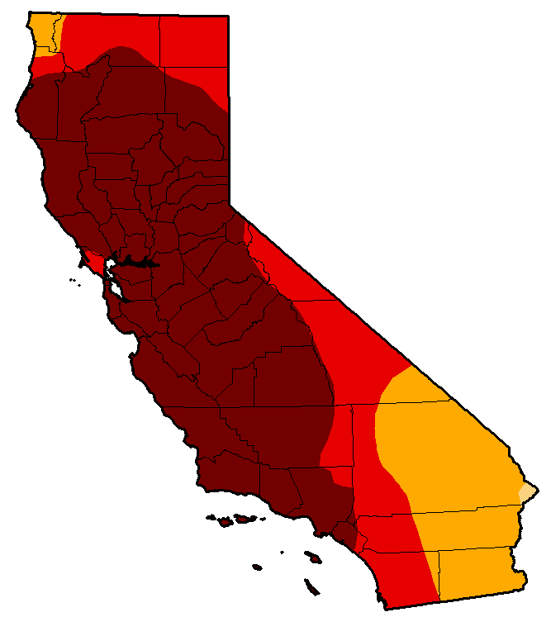
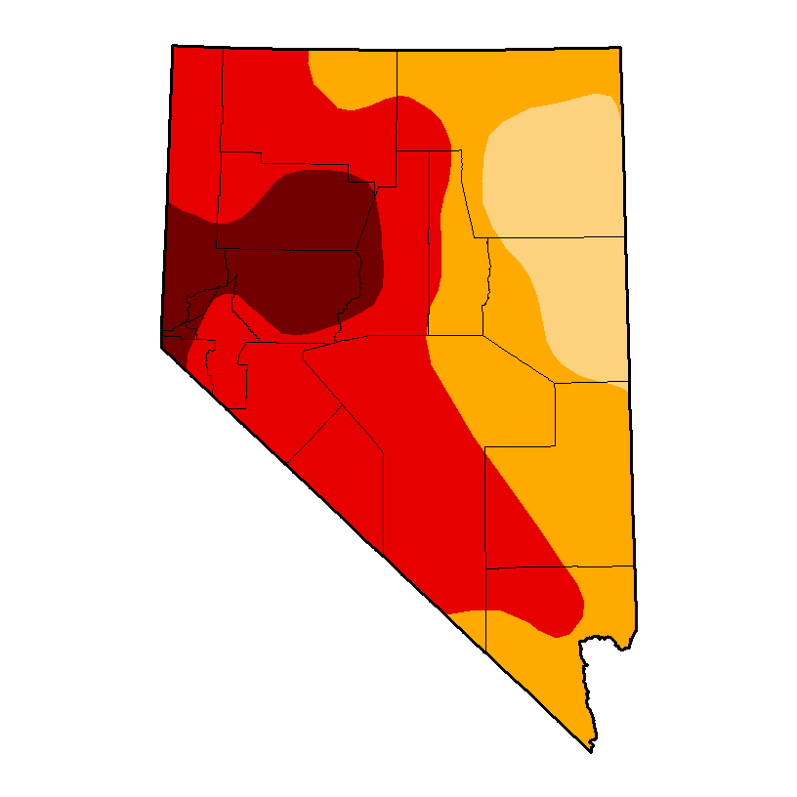
Drought Monitor
August 12, 2014
Exceptional Drought: Intensification of drought
The 12 August drought monitor shows D4 (exceptional) drought conditions over 58% of California (compared to 25% 3 months ago).
Over Nevada the extreme and exceptional drought area covered 67% of the state (compared to 47% 3 months ago).

Slide 2
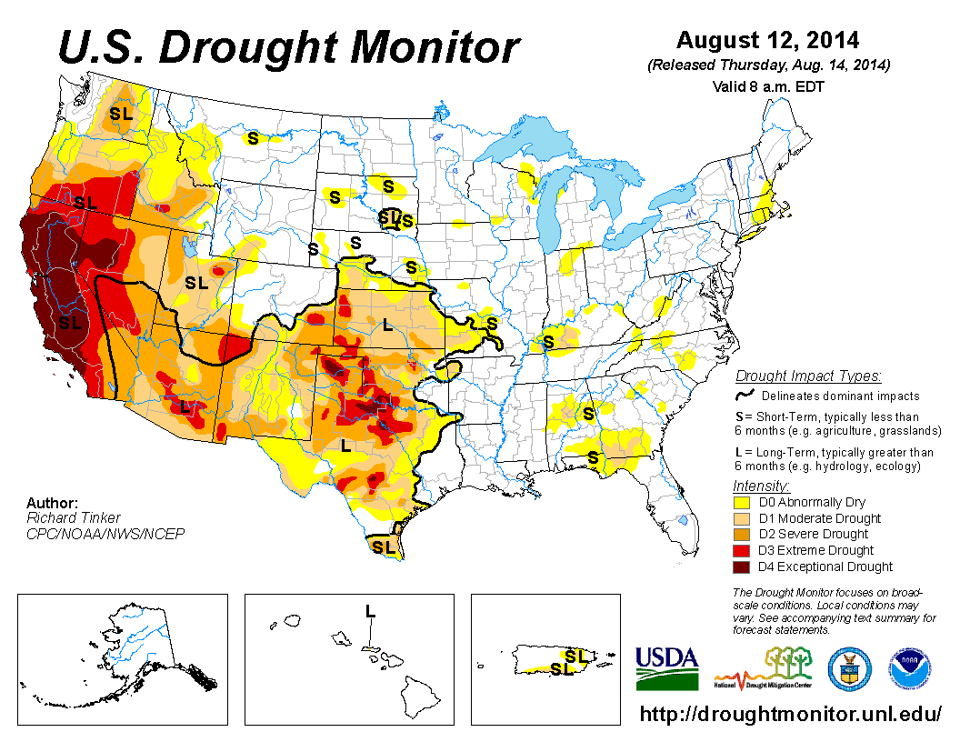
California and Nevada Drought is extreme to exceptional

Slide 3
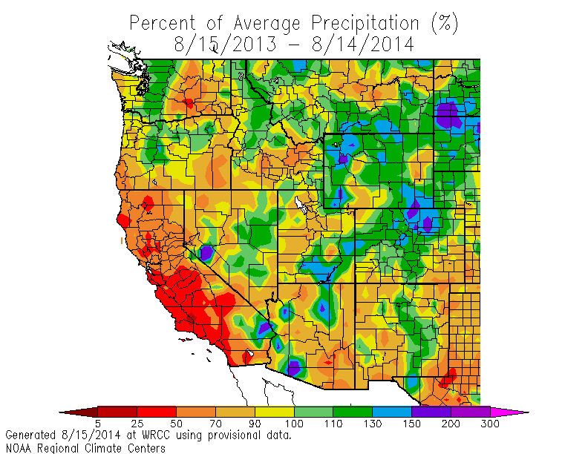
The percent of normal precipitation since August 2013 shows much of California at less than 50% of normal. Other parts of the west are also dry.

Slide 4
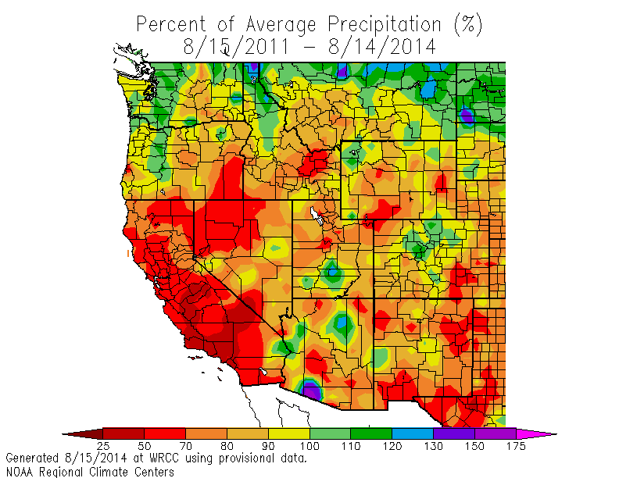
The percent of precipitation over the last THREE years shows much of California and Nevada at less than 70% of normal.

Slide 5
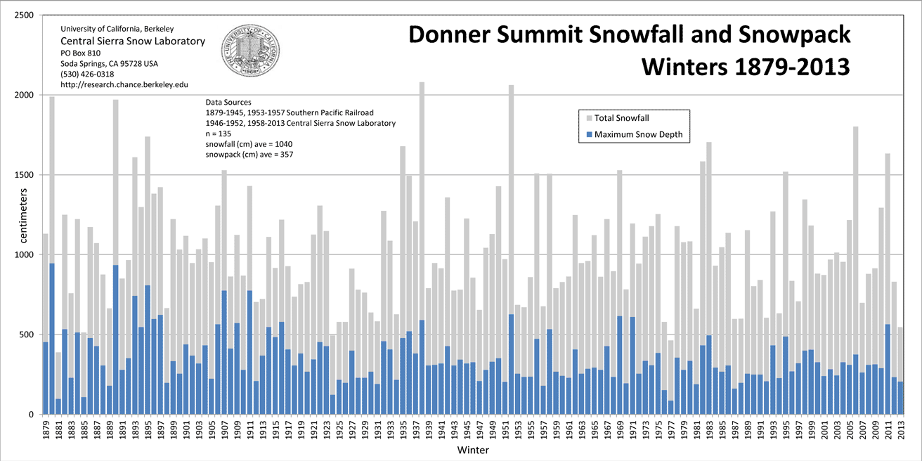
Donner Summit Snowfall
(gray bars)
Snowfall was below normal for 17 years between 1987-2013 (63% of the years). Records go back over 110 years.

Slide 6
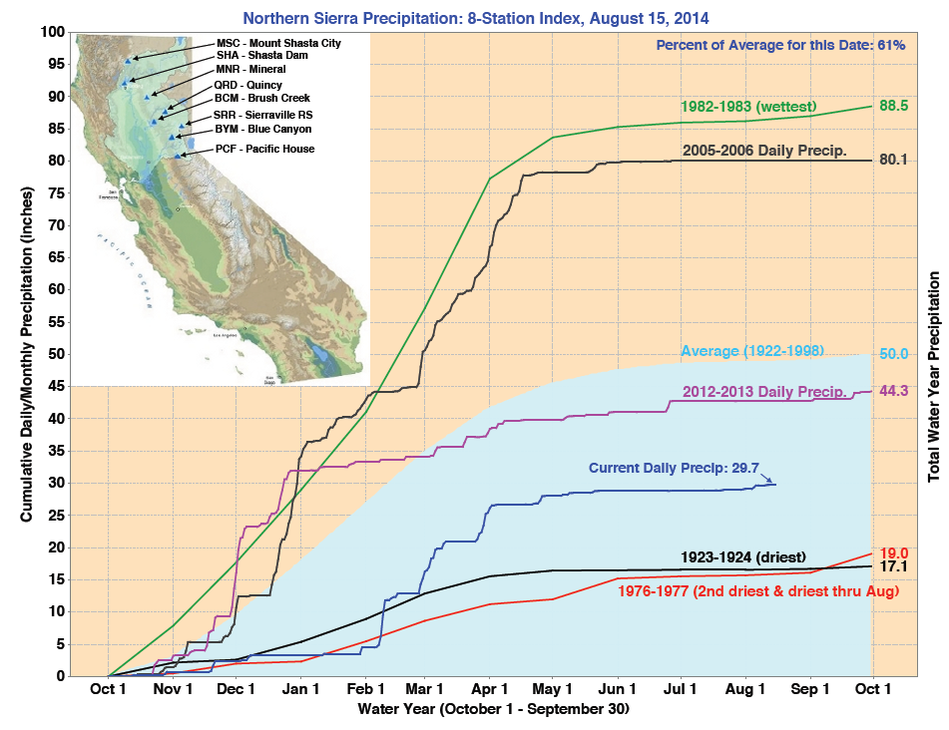
The Northern Sierra Precipitation 8-station index remains below the amount at this time last year (2012-13). Note last year ended below normal.

Slide 7
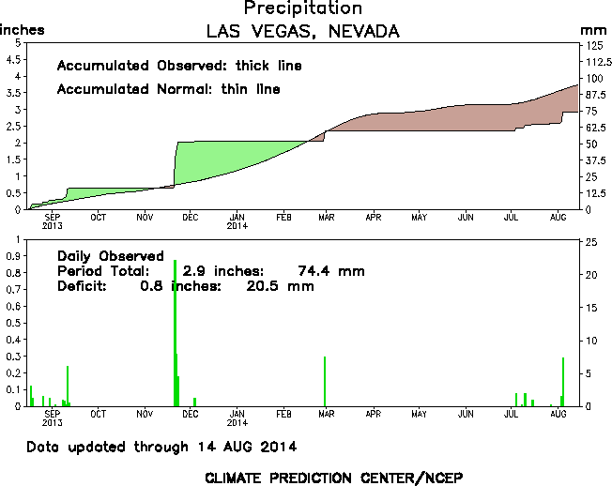
Las Vegas 365-day precipitation deficit: 78% of normal

Slide 8
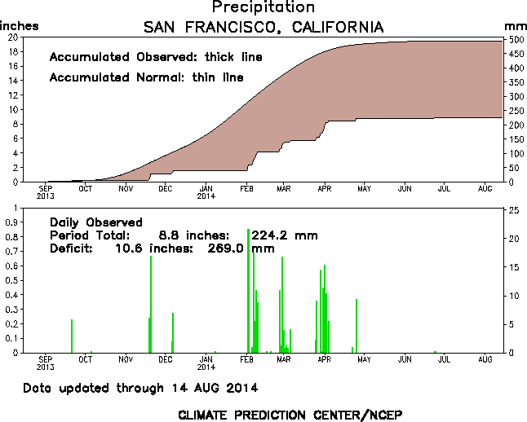
San Francisco 365-day precipitation deficit: 45% of normal

Slide 9
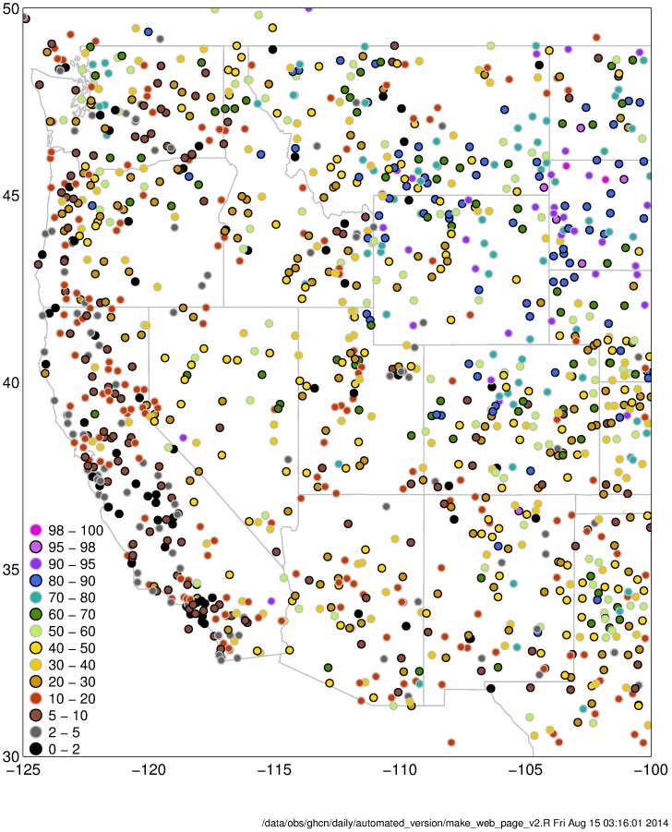
From CNAP researcher David Pierce:
Observed water year-to-date precipitation percentile
Note swath of unusually low precipitation along the entire west coast.
This “dot” plot shows station precipitation percentile. Each dot shows a station that has reported data in the last 30 days (data from the GHCN). The values reflect the amount of precipitation that has fallen since October 1, 2013. A value of 50% is normal (a light green dot). Black shows stations in the 0-2 percentile.
http://cirrus.ucsd.edu/~pierce/stainfo/

Slide 10
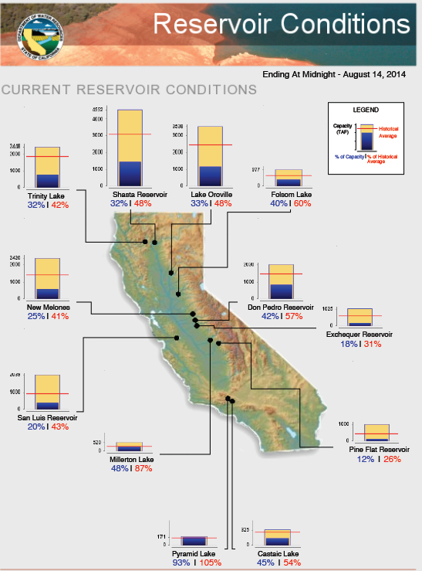
California reservoirs are well below normal in the central to northern regions of the state.
Blue numbers show percent of capacity. Red numbers show percent of historical average.

Slide 11
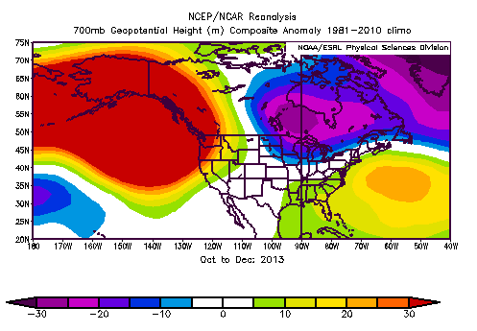
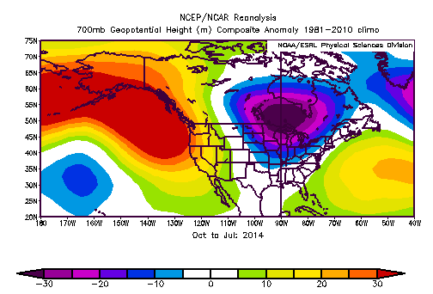
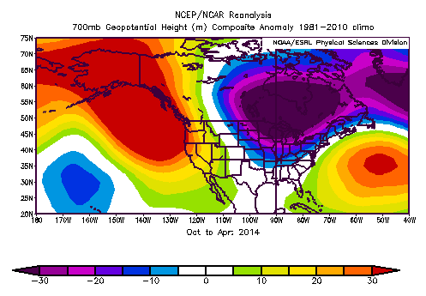
High pressure has dominated the eastern Pacific since October 2013
October through December 2013
October 2013 through July 2014

Slide 12
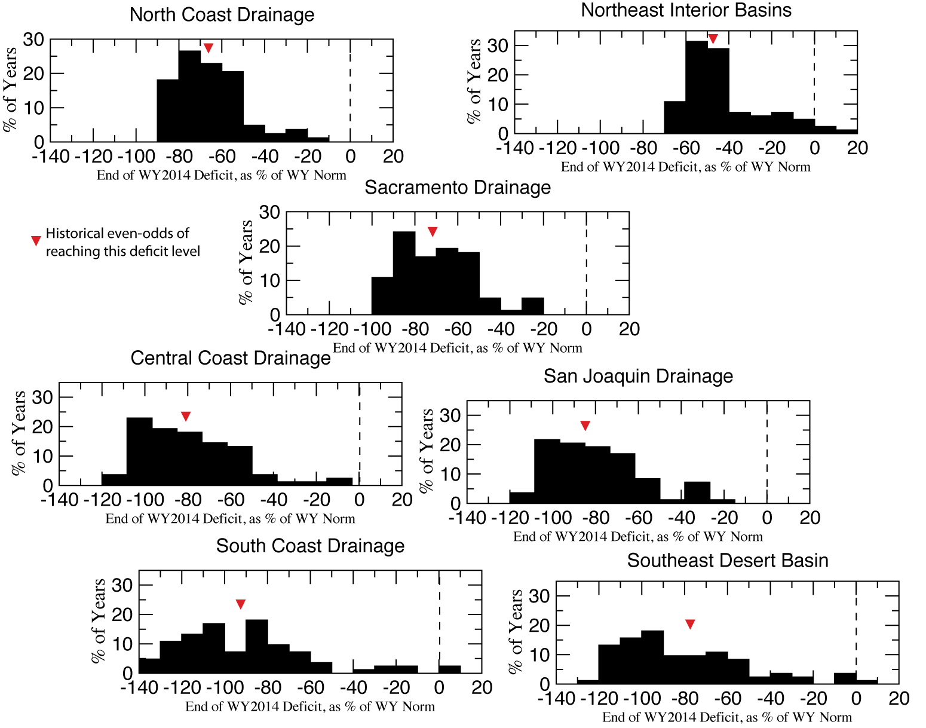
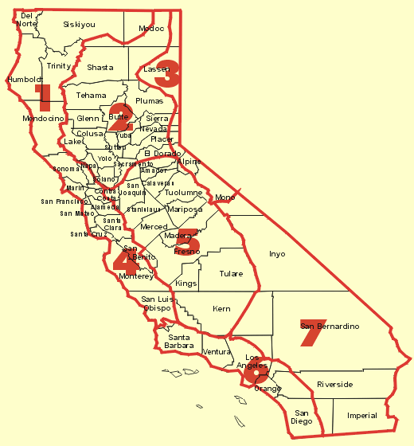
Division | % of normal by Oct 2014
1 | -67
2 | -72
3 | -48
4 | -81
5 | -85
6 | -92
7 | -79
Can we recover from the drought?
Chances are slim …
The above histograms summarize the chances of drought recovery for the 7 California climate divisions. Starting with the water deficit from 2012-13 the percent of years that reach normal are tabulated above. The red inverted triangle indicates the historical even odds of where water year 2013-14 may end.

