Slide 1
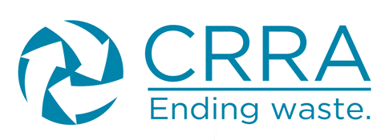
California Resource Recovery Association

Slide 2
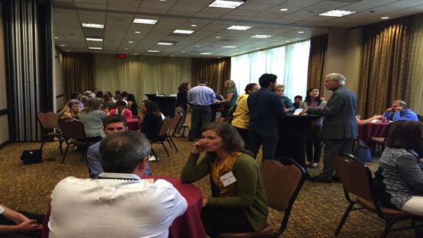
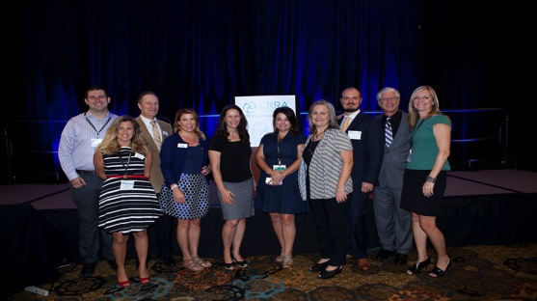
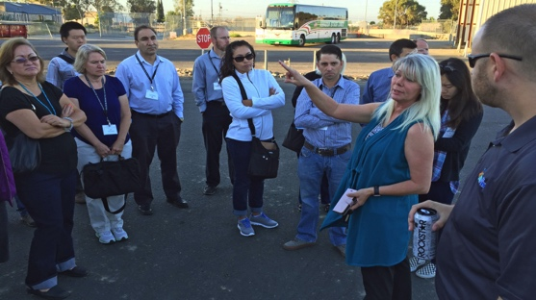
Who We Are
The California Resource Recovery Association (CRRA) was founded in 1974 and is California’s statewide recycling association. We are the oldest, and one of the largest, non-profit recycling organizations in the United States.
CRRA supports and encourages:
Environmental sustainability in and beyond California
Zero Waste strategies including
Product stewardship
Waste prevention
Reuse
Recycling
Composting

Slide 3
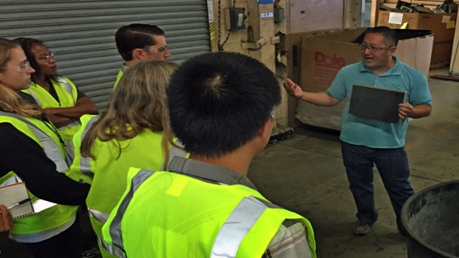
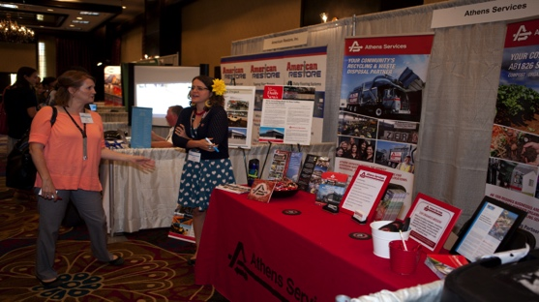
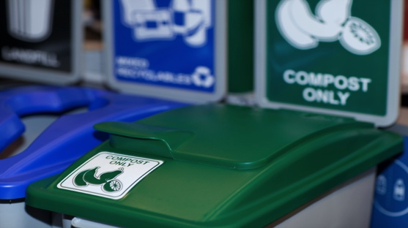
Where Our Members Come From
CRRA’s members represent all aspects of California’s reduce-reuse-recycle-compost economy. Our members come from
Cities (Hey! That’s you guys!)
Counties
State Agencies
Municipal Districts
Private Businesses
Hauling Companies
Materials Processors
Nonprofit Organizations
Professional Organizations Like Colleges

Slide 4
What We Provide To Our Members
Resources to advance local, regional and state wide waste reduction efforts which result in critical environmental and climate protection outcomes.
Networking Opportunities with like-minded professionals.
A Job Board highlighting internships and career positions in the industry.
Classes and Certifications to ensure life-long learning and up to date information on Local, State and Federal mandates.
Annual Conference where nationally recognized speakers and rule-makers gather to learn and teach the professionals who attend.
Student Memberships for those who envision a career in the recycling industry and want to make connections early.

Slide 5
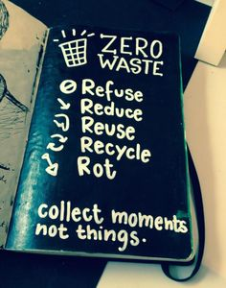
How A Zero Waste Lifestyle Works
You can
Refuse to purchase things you don’t need
Reduce your consumption
Reuse and Repair things
Recycle everything that can be recycled
Rot your organics

Slide 6
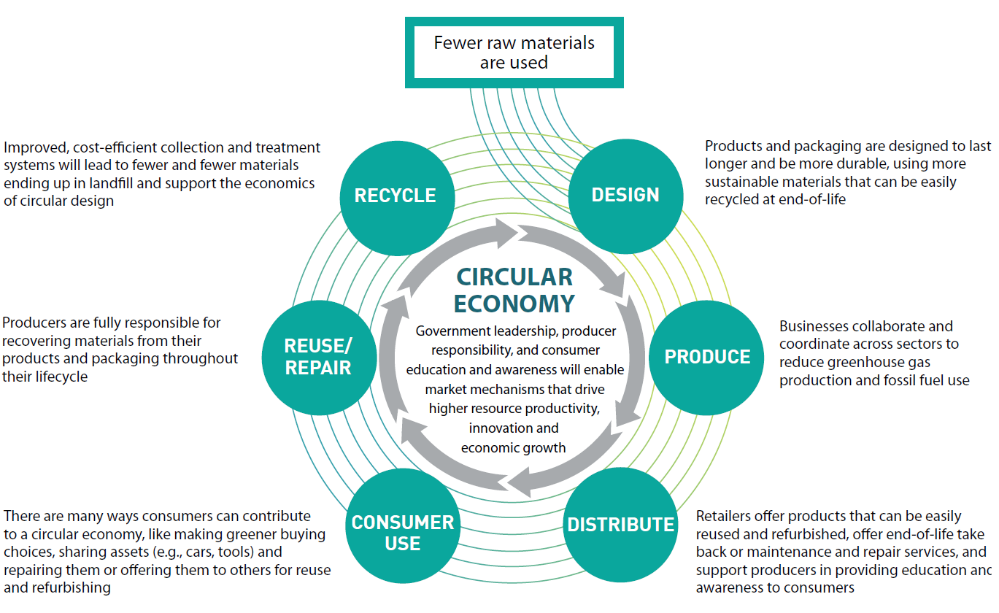
Cultivating A Circular Economy
So you can
Refuse to purchase things you don’t need
Reduce your consumption
Reuse and Repair things
Recycle everything that can be recycled
Rot your organics

Slide 7
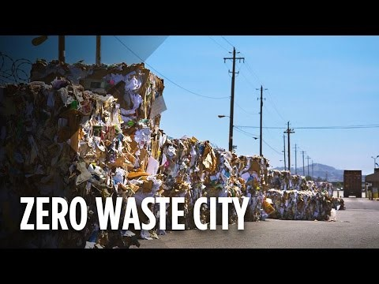
San Francisco has a world-class zero waste program. The City’s 3 bin system, policies, financial incentives, and extensive outreach to residents and businesses, helped San Francisco achieve the highest diversion rate of any major city in North America. San Francisco diverts 80% (1,593,830 tons diverted in 2010) of its discards from the landfill. So what does it take? Watch and see!
Zero Waste At A Bigger Level

Slide 8
Certified Zero Waste Practicioner
In partnership with SWANA, the CRRA now offers a best in class Zero Waste Certification class designed to help you understand:
The concepts of Zero Waste
The various different definitions and perspectives around Zero Waste
What’s in your waste stream?
Upstream, Midstream and Downstream Zero Waste strategies as they affect each stage of product lifestyles
Collections Options
Processing Technology Options
How to manage Organics
Working with Public Venues and Challenging Materials
How to Change Behavior through Education and Outreach
The ins and out of Financing and Funding
Opportunities for Contracting and Partnerships
That We Provide customized classes for groups (Hey! That’s you guys again!)

Slide 9
What Can CRRA Do for you?
What things would you be interested in CRRA doing with or for you? Can we bring you:
Webinars on topics like National Sword or SB1383?
What other topics would you like?
Zero Waste Principles and Practices class at your location?
One day seminars?
Special guest speakers for your meetings?
Are you:
A member of any of our Technical Councils??
Planning to attend our CRRA Conference in Oakland July 26-28?
Planning to submit yourself or any of your colleagues for a CRRA Award?
Interested in working on a CRRA board committee or being a part of the board?
Interested in sponsoring or mentoring a young professional new to the industry?

Slide 10
California Resource Recovery Association
Questions?
Jenna Abbott
Executive Director, CRRA
Jenna@crra.com

